Slide 1
2
0
1
8
Online Appointment Manage System
Xiaojing Liu, Lufeng Ren, Shawn Nha

Slide 2
1
Wait long time on phone to get customer service
Problems
2
Make/Cancel appointments are not flexible
3
Not convenient for English as second language people
4

Slide 3
Solution
For
Patient
For
Clinic/
Hospital
Save time/trouble
Visualize
Easy Access
7/24 convenience
Save labor cost
Save time/trouble

Slide 4
Market
By 2007, 19.7% of population in US who don’t speak English.
19.7%
20.8%
From the 2011 American Community Survey, it increased to 20.8% -- about 1/5 of all people living in US.
Reference: Reference: https://www.citylab.com/equity/2013/08/geography-americas-many-languages/6438/

Slide 5
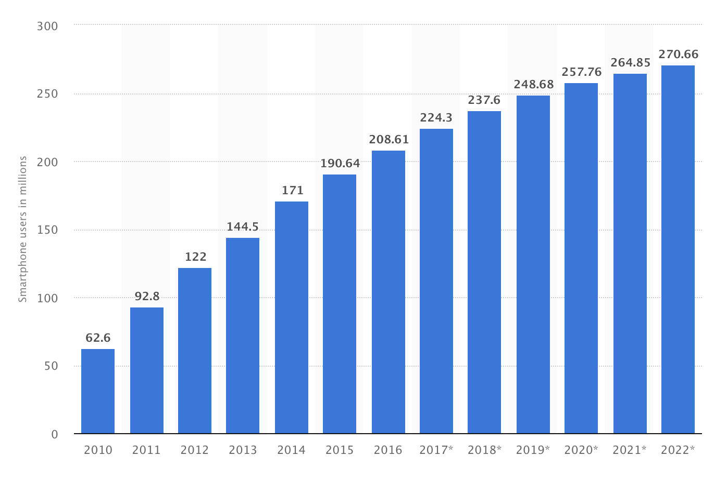
Market
Number of smartphone users in the United States from 2010 to 2022(in millions)
Reference: https://www.statista.com/statistics/201182/forecast-of-smartphone-users-in-the-us/

Slide 6
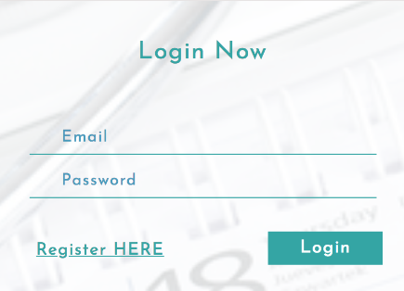
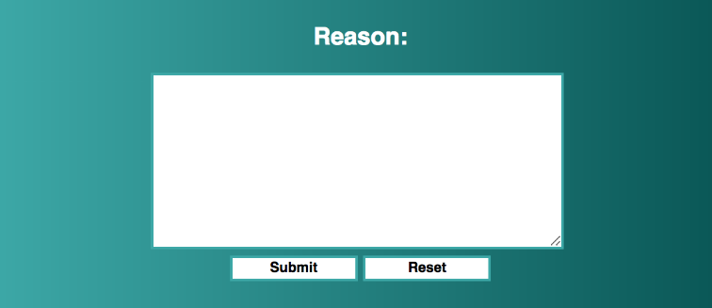
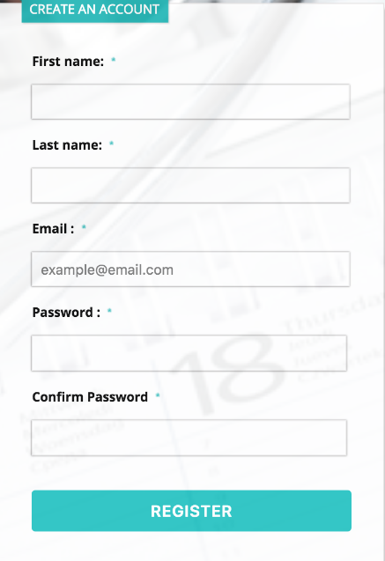
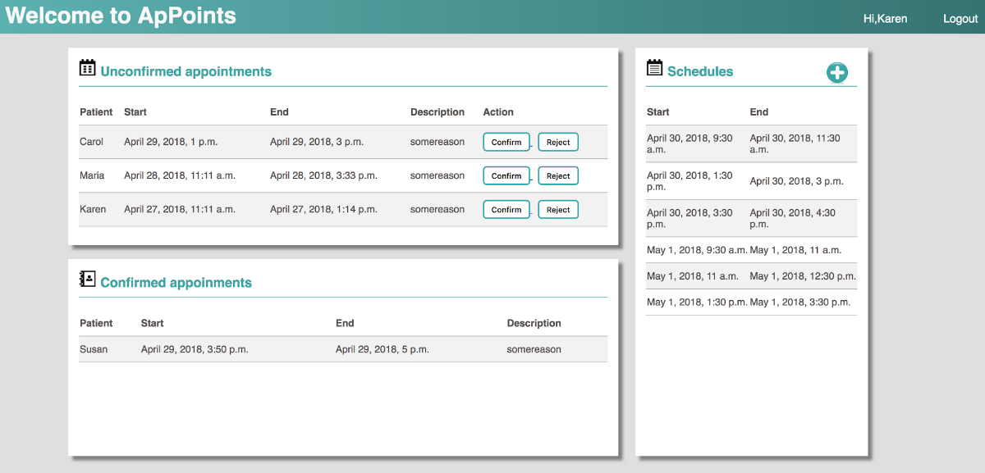
Platform Demo

